Slide 1
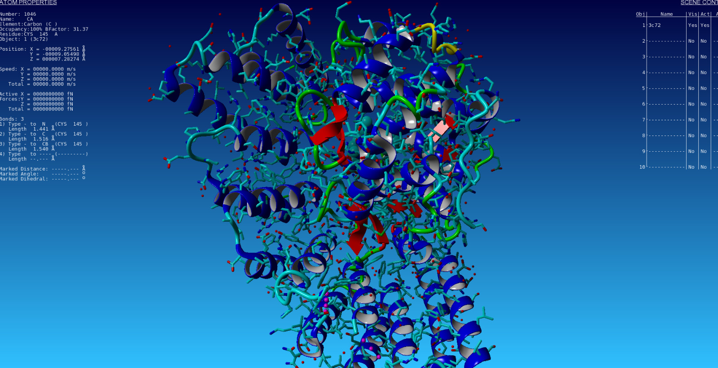

Graph Based prediction of Protein Stability Changes Induced by Single Point Mutations
CENTRE FOR COMPUTATIONAL BIOLOGY AND BIOINFORMATICS
CENTRAL UNIVERSITY OF HIMACHAL PRADESH
(Accredited by NAAC A+)
SHAHPUR, KANGRA,176206
Course Code: BIN595
End Term Examination
Presented by:
Sanjay Singh Chauhan
CUHP22CBB41
M.Sc.Bioinformatics, 4th sem
Under the guidance of:
Prof. Mahesh Kulharia
DATE- 06.08.2024

Slide 2
Contents
Introduction
Objectives
Methodology
Prediction with the existing Dataset with one engineered feature
New feature engineered by Regression model
Mega-scale experimental analysis dataset of protein folding stability
PDB mutations
Graph Construction of wild Pdb and mutant Pdb
Application GAT algorithm for prediction of Gibb’s free energy
Results
Conclusion
Acknowledgment
References

Slide 3
Introduction
Mutation in protein sequence by single amino acid changes the protein structure thus protein stability is changed which can be represented and calculated in the form of change in Gibb’s free energy to determine that this mutation will be destabilizing or stabilizing
Gibbs Free Energy, denoted as G or ΔG, is a thermodynamic quantity used to determine the spontaneity and equilibrium of a chemical reaction or physical process under constant temperature and pressure conditions
Normally we can find the change in gibb’s free enrgy for those mutations which has already occured by experimental methods which is time consuming also
Thus i have studied some tools which are used in predicting the change in Gibb’s free Energy. but they takes the very traditional approach to use the seq or structure for prediction has less accuracy with more false postive score

Slide 4
Objectives
To create a dataset of mutations and their corresponding change in gibb’s free energy
To create a better prediction model than the existing models with least false positive rate as much possible with including the mutations that these models has not used
Testing & validation of the dataset with linear regression and creating new Graph Based algorithm
Feature engineering with creating new features that help in increasing the accuracy

Slide 5
Methodology
Data Collection (Mutant PDB)
Data Collection (wild PDB)
Collection of change in Gibb’s Free energy of Wild & Mutant pdb
Wild Type graph Construct
Mutant Type graph Construct
Feature Engineering (node Features)
Graph Attention Neural Network (GANN) Setup
Model Training
Validation By K-Fold Method

Slide 6
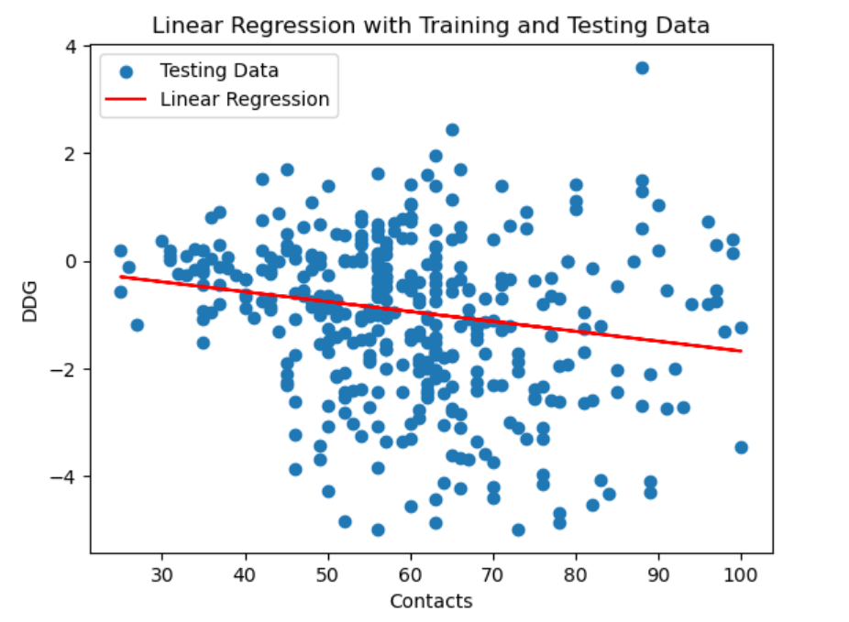
Prediction with the existing Dataset with one feature engineered
I have used the (S2468) dataset which is a standard dataset containing 2648 mutations in 132 proteins which is also used in SAFFEC-SEQ tool
I have created a new feature in a existing dataset called as contact which is a numerical column containing the information of each pdbid with taking the mutation site number of contact the mutant amino acid makes with other amino acid with taking the distance
cut-off =5.0 Angstrom
The accuracy was not good as expected with a
single feature 34%

Slide 7
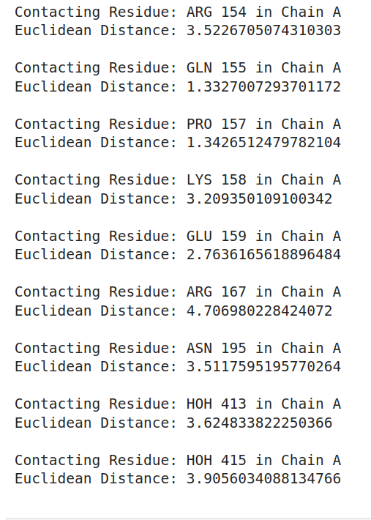
New feature engineered
After finding that one feature is not sufficient for prediction model than new feature are also engineered like finding the contacting Residues for each mutation site and their euclidean distance for each entries with distance cut-off of=5.0Angstrom
This figure is representing contacting amino
acids of 1a43.pdb at 156 position

Slide 8
Mega-scale experimental analysis dataset of protein folding stability
This dataset contain information about the 862 proteins with 217731 mutations single point mutations change in gibb’s free energy values and protein id
I have created 217731 mutated pdb’s by using the yasara(yet another scientifically reality application)
And now i have a dataset with wild type protein id,mutant protein id ,and wild type sequence and mutated sequence

Slide 9
PDB mutation
Making the the mutation site pdb is also crucial
For doing this task I have used YASARA(Yet another scientific Artificial Reality Application) Tool to induce the the mutation at a particular site by doing the single point mutation
These pdb differs with the original pdb with the mutation places only but the mutation directly or indirectly has changed the properties of the pdb or the stability
Alll the pdb 862 has gone with mutation 217731 has gone this number of mutation one pdb has gone with 252 mutation at the same place or different with changing the amino acid Residue

Slide 10
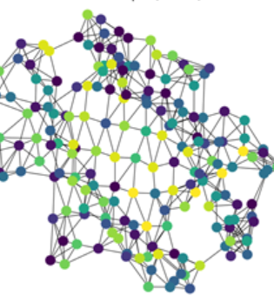
Graph Construction of wild Pdb and mutant Pdb
The wild Pdb and mutant pdb are represented in the form of the Graph of one graph represent one pdb and I have made all the wild and mutant pdb graph
The graph is mainly in the form of nodes and edges where the nodes represents an entity or a data point and in this it represents the amino acid residue of the pdb and the edges represents the connections or type of bond like Covalent , ionic, sulphide ,hydrogen Bonds.
The graph also contain the node features which i have used the 9 different Phsiochemical Properties of each amino acid values as the feature so if the pdb contain 50 amino acid Residue then the node Feature Matrix will be of 50*9
This figure is a protein Graph where the nodes are representing the amino acid and the edges represent the type of bond

Slide 11
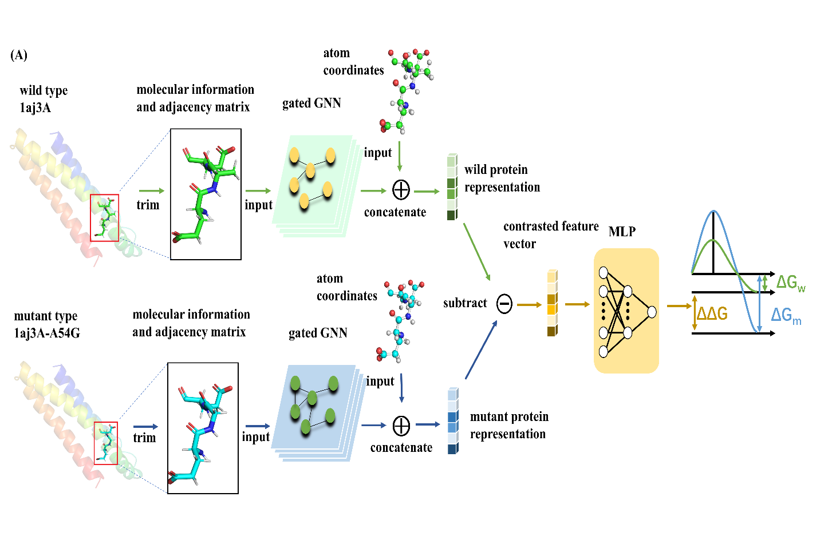
Applied GAT algorithm for prediction of Gibb’s free energy
For applying the the graph Attention neural network Mechanism in my Work I have saved the nodes Feature matrix and adjacency Matrix in Json file format of each pdb
Then I have Tried to make a graph Pair one wild and its Mutant one Pdb’s Json to Concatenate their Matrix and Feature Matrix For one Prediction and Done for all of them
After doing this I have used The Standardization Method and used Two layers to feed it one Leaky ReLu and other is Linear
The dataset is Split in 70% and 30 % from the 70% it is split into 80 and 20% for training and testing
The Graph use attention mechanism to make a new embedding layer which is feed into the Neural Network

Slide 12
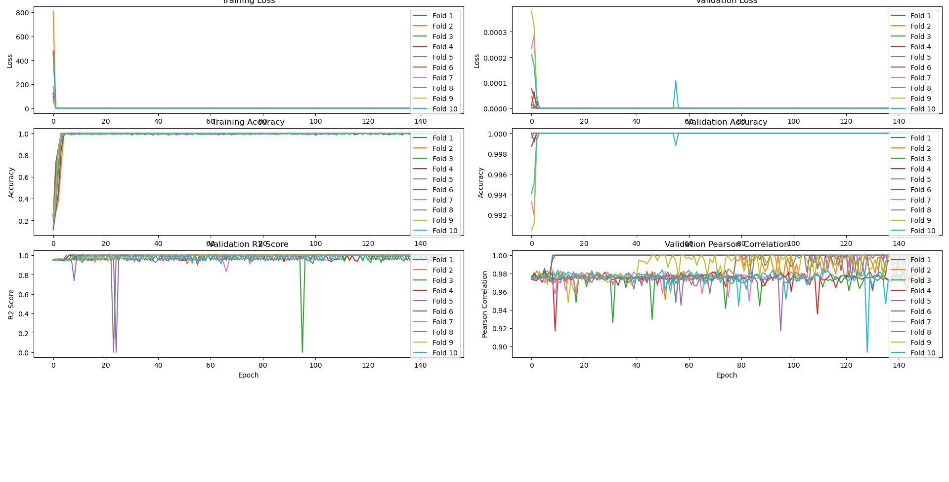
Results
My model has achieved the accuracy in of PCC(Pearson Correlation coefficient) of 0.98 and and R2 Score of 1
I have done 10fold cross validation where 8th model performed the Best with 150 epochs

Slide 13
Conclusion:
We introduced a novel graph-based machine learning approach to predict the effects of single-point mutations on protein stability by estimating changes in Gibbs free energy (ΔG)
integrating both structural and sequence data and utilizing nine physicochemical properties as node features, our model demonstrated enhanced accuracy and robustness in predicting ΔG changes, even with limited structural data.

Slide 14
Acknowledgement
I wish to express my sincere and profound gratitude to my supervisor, Prof. Mahesh Kulharia Head of Dept., Centre of Computational Biology and Bioinformatics, Central University of Himachal Pradesh, Shahpur (Kangra).
I am thankful to Dr. Manorma Patri, Dr. Vikram Singh, Dr. Dinesh Lakhanpal, Dr. Sandeep Swargam and Dr. Neha Choudhary for their continuous support during my M.Sc. tenure.
I wish to express my sincere thanks to R&D scholar Miss Ashita Sood and my classmates for their cooperation, advice, inspiration, support and help during the course of research work.

Slide 15
References
Kellogg, E. H., & Leaver-Fay, A. (2016). Molecular Dynamics: A Tool for StructureFunction Analysis of Biomolecules. Nature Methods, 13(10), 828–839. DOI: 10.1038/nmeth.3969
2. Yang, Y., & Zhou, Y. (2008). Specific Interactions for Ab Initio Folding of Protein Terminal Fragments with Secondary Structures. Proteins: Structure, Function, and Bioinformatics, 72(2), 793–803. DOI: 10.1002/prot.21948
Parthiban, V., & Gromiha, M. M. (2007). Analysis and Prediction of Exposed Loop Regions in Proteins. Proteins: Structure, Function, and Bioinformatics, 71(1), 421–431. DOI: 10.1002/prot.2167
Bendl, J., Stourac, J., Sebestova, E., Vavra, O., Musil, M., Brezovsky, J., & Damborsky, J. (2016). HotSpot Wizard 2.0: automated design of site-specific mutations and smart libraries in protein engineering. Nucleic acids research, 44(W1), W479-W487.
Traditionally, predicting ΔΔG involves computationally intensive methods such as molecular dynamics simulations, which, despite their accuracy, can be prohibitively slow and resource-demanding for large-scale studies. This has driven the search for more efficient computational models that can leverage existing structural data and sophisticated machine learning techniques to provide accurate and scalable predictions

Slide 16

while i_am_smiling >= problems :
print(“Happiness”)
else :
print(“I will find a way to become happy”)
THANK YOU !

